Slide 1
Estimation of energy performance of residential buildings

Slide 2
Objective:
Development of a predictive model for monitoring heating and cooling load for
different building shapes. The model will determine the values of load based on
inputs.
Benefits:
Detection of heating load and cooling load.
Gives better insight of energy efficiency from different building shapes.
Helps to find energy efficient building.

Slide 3
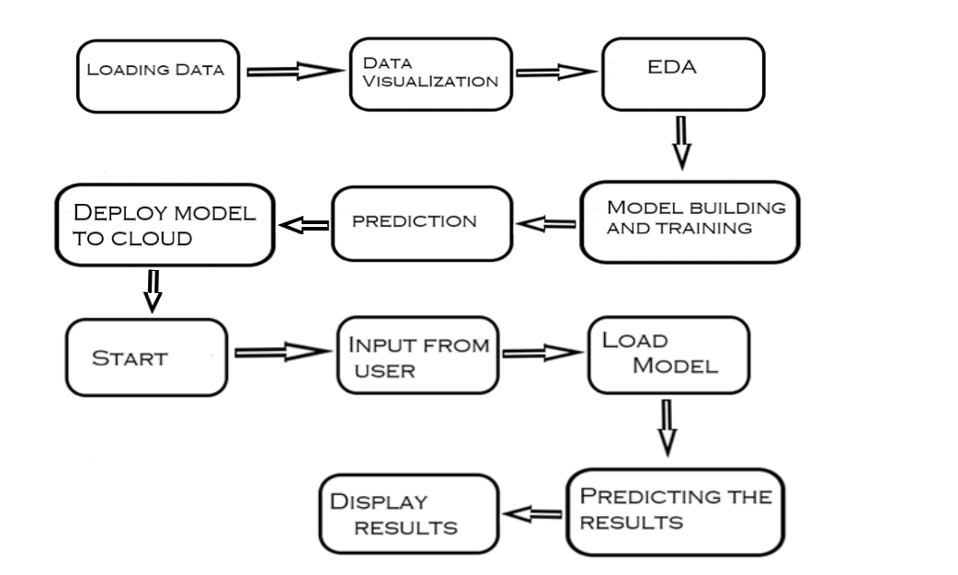
Architecture

Slide 4
Data Description:
The dataset is of Energy efficiency for Building. The buildings differ with respect to the glazing area, the glazing area distribution, and the orientation, amongst other parameters. The dataset comprises 768 samples and 8 features.
The dataset contains eight attributes and two responses.
X1=Relative Compactness
X2=Surface Area
X3=Wall Area
X4=Roof Area
X5=Overall Height
X6=Orientation
X7=Glazing Area
X8=Glazing Area Distribution
Y1=Heating Load
Y2=Cooling Load

Slide 5
Data Visualization:
Use matplotlib and seaborn for data visualization.
May need to check whether our attributes contain outliers or not. Because outlier result in a poor fitting and lower predictive modeling performance.
So, with the help of boxplot we see the outliers. Outliers i.e the values below 25% and above 75% in plot.

Slide 6
Model Training:
Data loading:
Dataset is in .xlsx format so we can import it using “read_excel” with help of pandas library.
Data Preprocessing :
Performing EDA to get insight of data like identifying distribution , outliers ,trend
among data etc.
Check for null values in the columns. If present impute the null values.
Data Preparation:
we split data into training and testing set.

Slide 7
Data Visualization :
After features are created, we will find the best model for our data. Different algorithms will be passed with the best parameters. We need to choose variables that we think we’ll be good predictors for the dependent variable — that can be done by checking the correlation(s) between variables, by plotting the data and searching visually for relationship, by conducting preliminary research on what variables are good predictors of y etc.
We will calculate the RMSE and R2 scores for models and select the model with the best score.

Slide 8
Prediction:
Here we will collect data from user such Relative Compactness, Surface Area, Wall Area, Roof Area, Overall Height, Orientation, Glazing Area, Glazing Area Distribution;
Data Validation will be done on inputs given by the user.
We perform data pre-processing techniques on it.
The model having highest accuracy for a given data is called and use for prediction i.e Random Forest.
After calling model result will be displayed with the values of heating and cooling load on the basis of data provided by user.

Slide 9
Q & A:
Q1) What’s the size of data?
The dataset comprises 768 samples and 8 features, aiming to predict two real valued responses
Q 2) What was the type of data?
The data was the combination of numerical and Categorical values.
Q 3) What’s the complete flow you followed in this Project?
Refer slide 4th for Architecture

Slide 10
Q 5) How logs are managed?
We are using different logs as per the steps that we follow in validation and
modeling like File validation log , Data Insertion ,Model Training log , prediction log
etc.
Q 6) What techniques were you using for data pre-processing?
Removing unwanted attributes
Visualizing relation of independent variables with each other and output variables
Checking and changing Distribution of continuous values
Removing outliers
Cleaning data and imputing if null values are present.
Splitting the data

Slide 11
Q 7) How training was done or what models were used?
After creating the training and validation data.
The Regression models like linear regression are applied and see the correlation between attributes.
By taking different combination of attributes try to fit the models
Algorithms like Decision, Extra tree, Random forest, Gradient boosting, XGBoost were used.
Calculate the RMSE and R2 scores for models and select the model with the best score.
Q 8) How Prediction was done?
Refer slide 9th for better understanding.

Slide 12
Q 9) Where the model is deployed?
When the model is ready we deploy it Heroku server.

